Slide 1
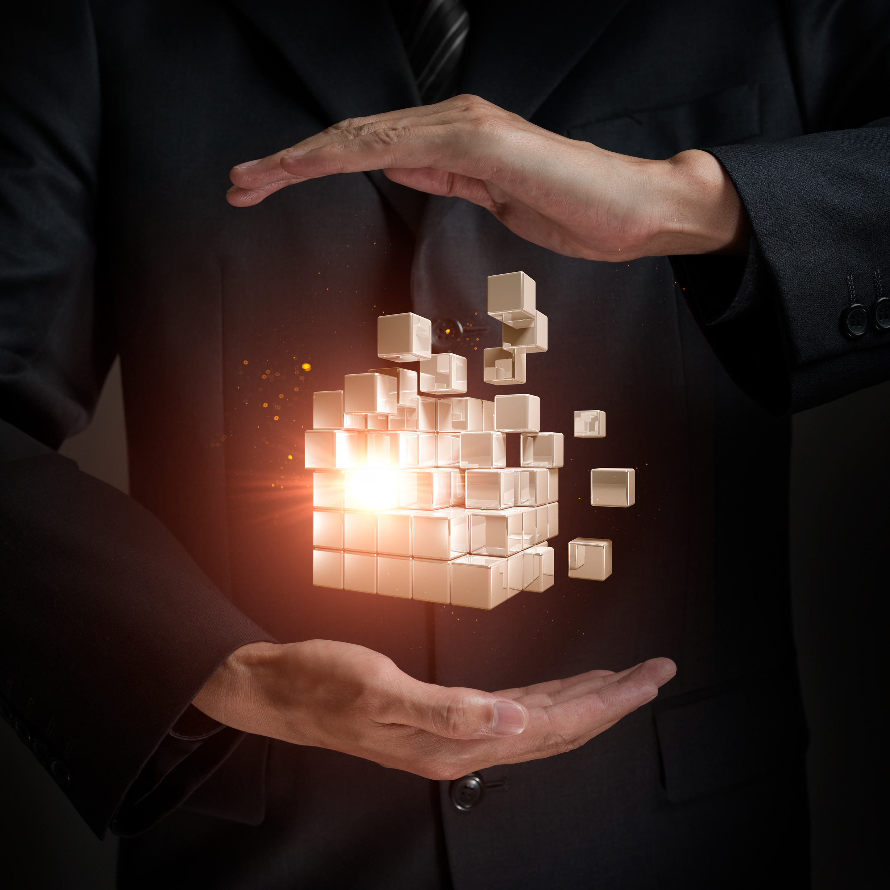
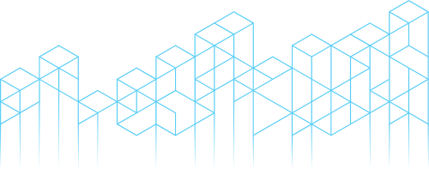

COMPILER FOR
AI-DRIVEN
IOT DEVICE AUTOMATION
Presented By :
B.HARSHITH(192210516)
N.V.Saicharan (192211384)

Slide 2

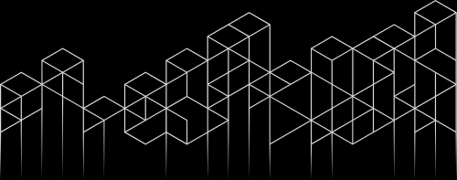
INTRODUCTION
A "Compiler for AI-Driven IoT Device Automation" addresses these challenges by offering a platform that bridges AI algorithms with IoT devices, streamlining the creation and deployment of intelligent automation workflows. Such a compiler acts as a translator, taking high-level AI models and rules as input and generating optimized, device-specific instructions to ensure compatibility and performance across an array of IoT devices.
By leveraging the power of AI, this compiler enables IoT devices to make autonomous decisions, learn from data, and adapt to changing environments. It supports a wide range of applications, from smart homes and industrial automation to healthcare and agriculture, empowering users with robust, scalable, and efficient IoT

Slide 3



THE ROLE OF COMPILERS IN IOT AUTOMATION
CODE GENERATION
OPTIMIZATION
DEPLOYMENT AND INTEGRATION
DEVICE-SPECIFIC ADAPTATION
Compilers translate high-level programming languages into machine-readable instructions for IoT devices.
Compilers optimize code for resource efficiency, energy conservation, and performance enhancements.
Implement and integrate solutions into existing systems and processes.
Compilers adapt code to the specific hardware and software characteristics of different IoT devices.

Slide 4


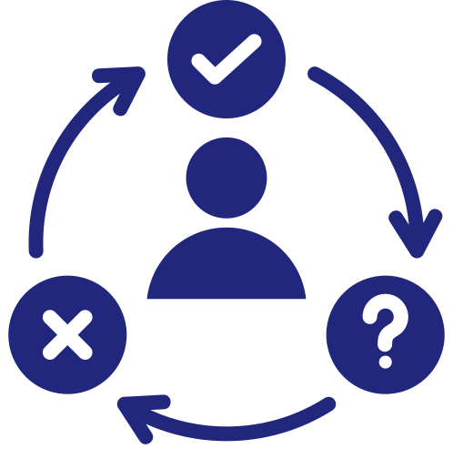
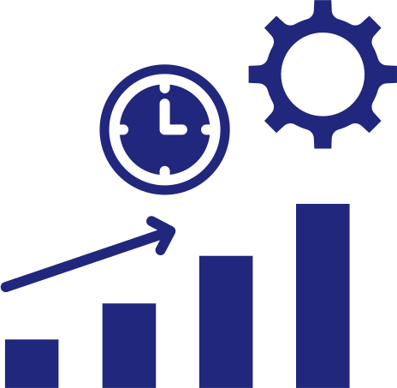

BENEFITS OF AI-DRIVEN
IOT DEVICE AUTOMATION
CROSS-PLATFORM COMPATIBILITY
REAL-TIME DECISION-MAKING
Works across various hardware and protocols, simplifying deployment in heterogeneous systems.
Enables devices to process and act on AI insights quickly, enhancing responsiveness.
COST AND TIME EFFICIENCY
SEAMLESS INTEGRATION
Reduces development effort and expenses by automating device-specific programming.
Bridges AI models with diverse IoT devices, ensuring smooth communication and functionality.

Slide 5
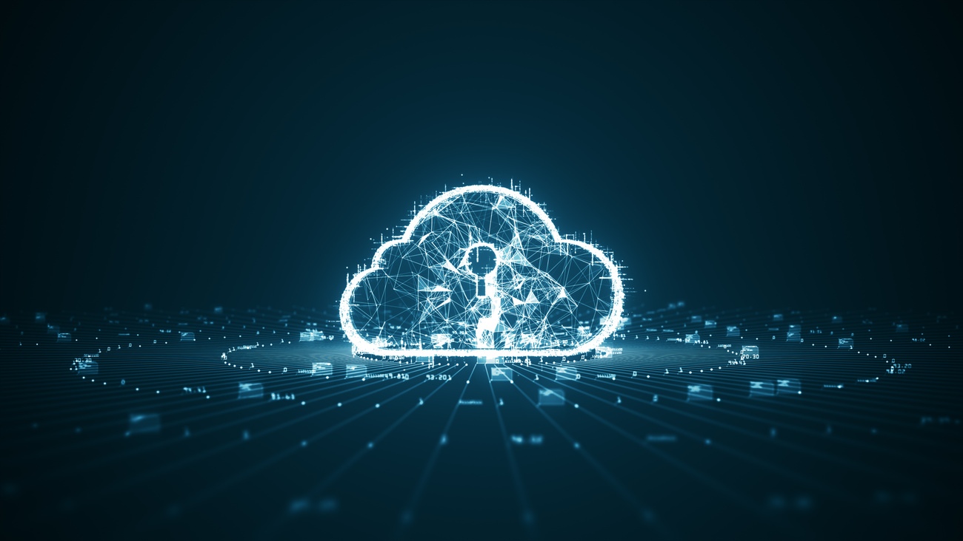
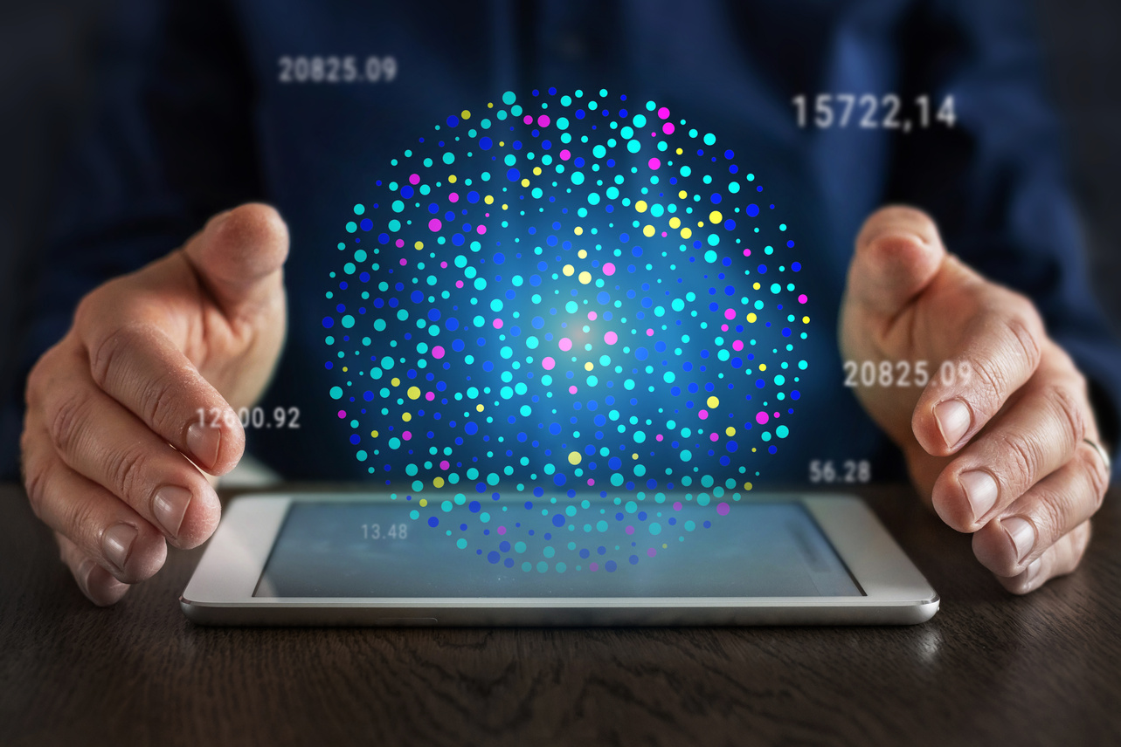
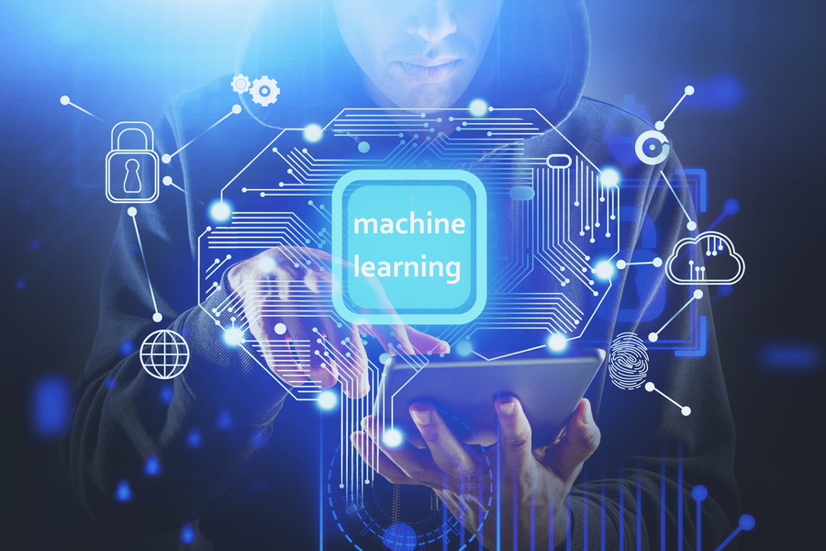
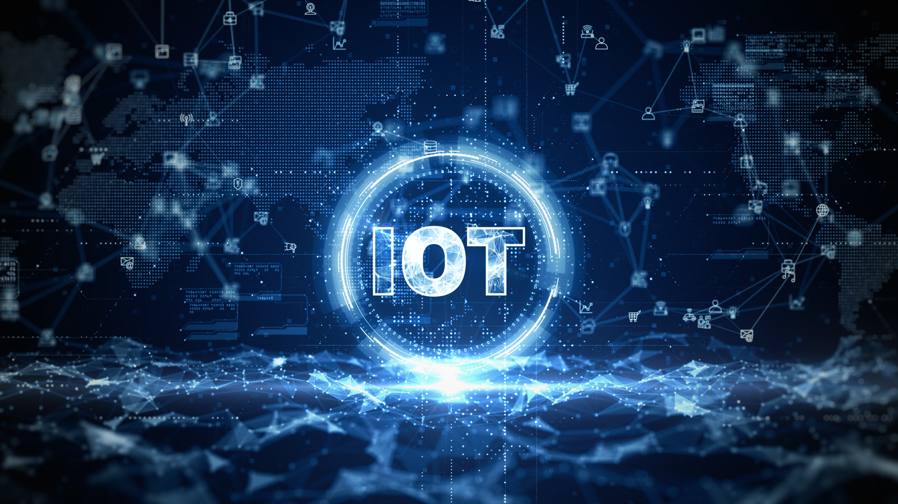
CHALLENGES FACED IN AI-DRIVEN IOT DEVICE AUTOMATION
STANDARDIZATION GAPS
SCALABILITY
RESOURCE CONSTRAINTS
HARDWARE DIVERSITY
Addressing the lack of universal IoT and AI integration standards, which hampers interoperability and development consistency.
Ensuring the system can handle growth, such as integrating new devices or scaling AI models, without performance degradation.
Generating optimized code for devices with limited processing power, memory, and energy.
Ensuring compatibility with a wide range of IoT devices, each with different architectures, protocols, and capabilities.

Slide 6

FEATURES OF AI-DRIVEN
IOT DEVICE AUTOMATION
A Compiler for AI-Driven IoT Device Automation serves as a bridge between high-level AI-driven logic and low-level IoT device execution. Its core purpose is to translate complex AI models and automation rules into machine-readable code tailored to the diverse capabilities of IoT devices. The theory behind such a compiler integrates principles of computer science, AI, and IoT systems to achieve efficient, adaptive, and intelligent automation.
OPTIMIZATION TECHNIQUES
SECURITY AND ROBUSTNESS
HIGH-LEVEL ABSTRACTION TRANSLATION
SCALABILITY AND MODULARITY

Slide 7
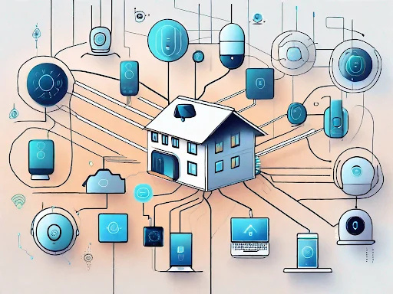
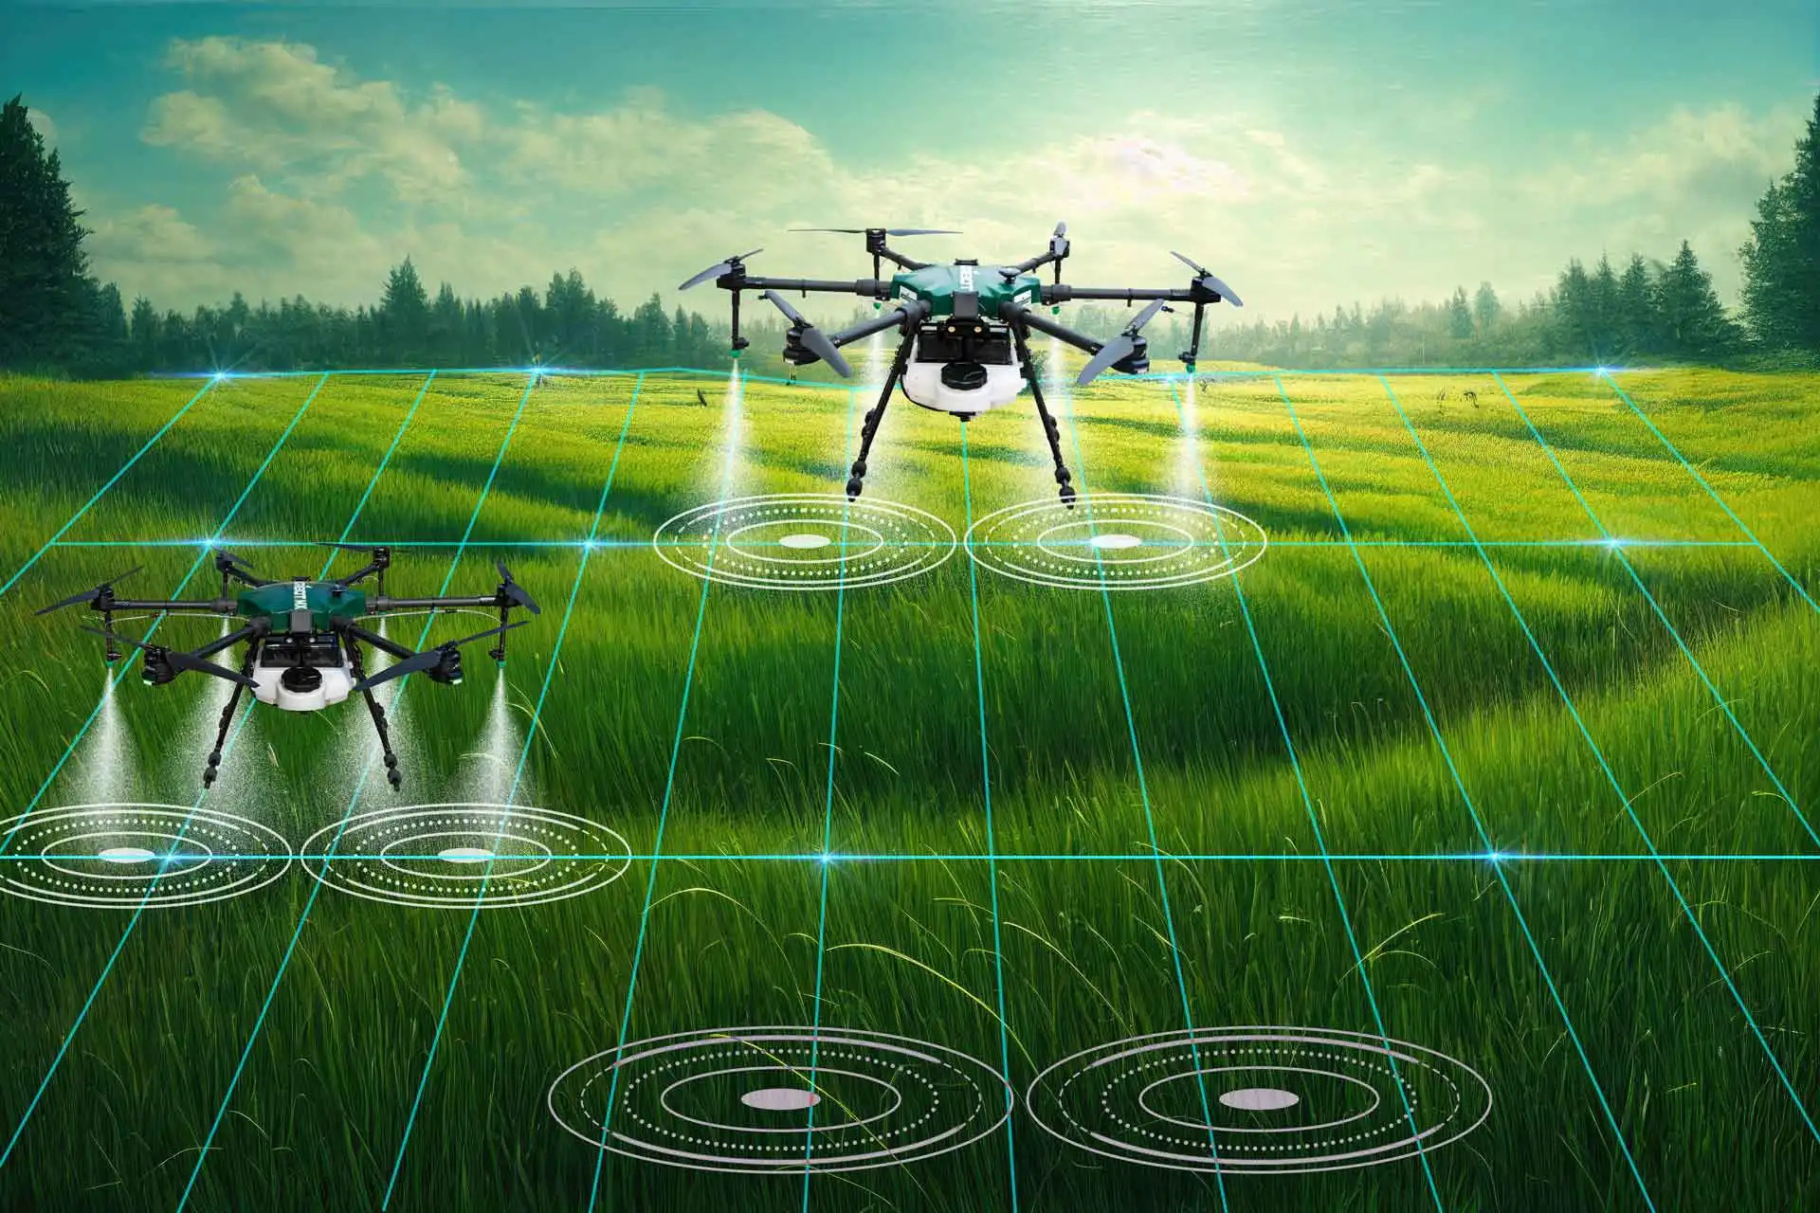
DEPLOYMENT SCENARIOS AND CASE STUDIES
SMART HOMES
Ensuring the system can handle growth, such as integrating new devices or scaling AI models, without performance degradation.
AGRICULTURE
AI-enabled automation optimizes crop yields, resource management, and environmental sustainability in farming.

Slide 8
CONCLUSION
A Compiler for AI-Driven IoT Device Automation is a transformative tool that bridges the gap between intelligent AI systems and diverse IoT ecosystems. By translating high-level AI models and automation rules into optimized, device-specific instructions, it simplifies development, enhances compatibility, and ensures efficient operation of IoT devices.
This innovation empowers real-time decision-making, scalability, and adaptability across industries such as smart homes, healthcare, agriculture, and industrial automation. While challenges like hardware diversity, resource constraints, and security remain, the benefits of streamlined workflows, cost efficiency, and intelligent automation make this technology a cornerstone for the future of smart, interconnected systems.

Slide 9
THANK YOU

